Slide 1
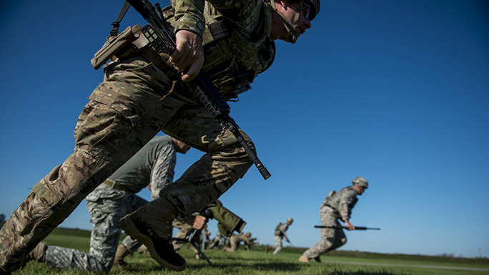
NDHQ Marksmanship Team - Kickoff

Slide 2
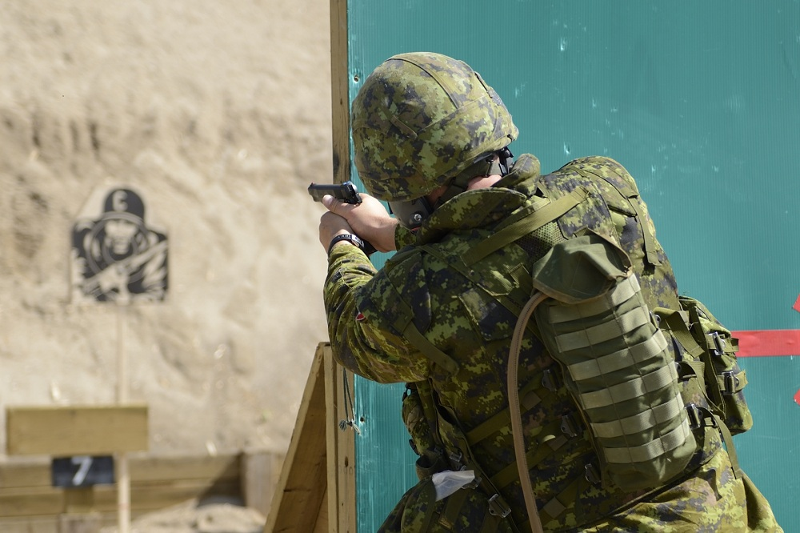
Agenda
Team Intro.
CAFSAC – What is it?
Marksmanship Principles.
Equipment.
What to expect.

Slide 3
Team Intro
Team Captain – MWO Lukas Rediger
Team Ammo and Booking Rep – Maj Henry Leung
Coaches – “Tom”, CPO1 Marty Cashin and WO Luke Foster.
Additional Senior Staff and RSOs/ARSOs not limited to:
  MCpl Jamie Lynam
  MCpl Dean Lynam
  Capt McAtamney, Julie
  Capt Joshua Taylor
  Maj Owen Bradbury
  Capt Fannie Simon
  Capt Frank Choi
  MCpl Tonia Coombes
  Cpl Lyne Milette
  Various Pers from GGFG

Slide 4
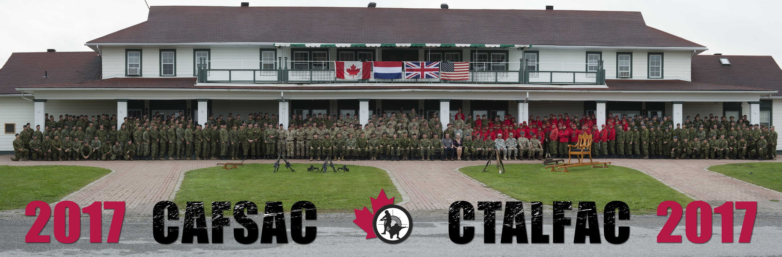
CAF Small Arms Concentration
What is it?
2 week competition Approximately 1-2 Week of Sept.
300+ competitors.
Several nations competing.
Reserve, Ranger and Regular Force Classes.

Slide 5
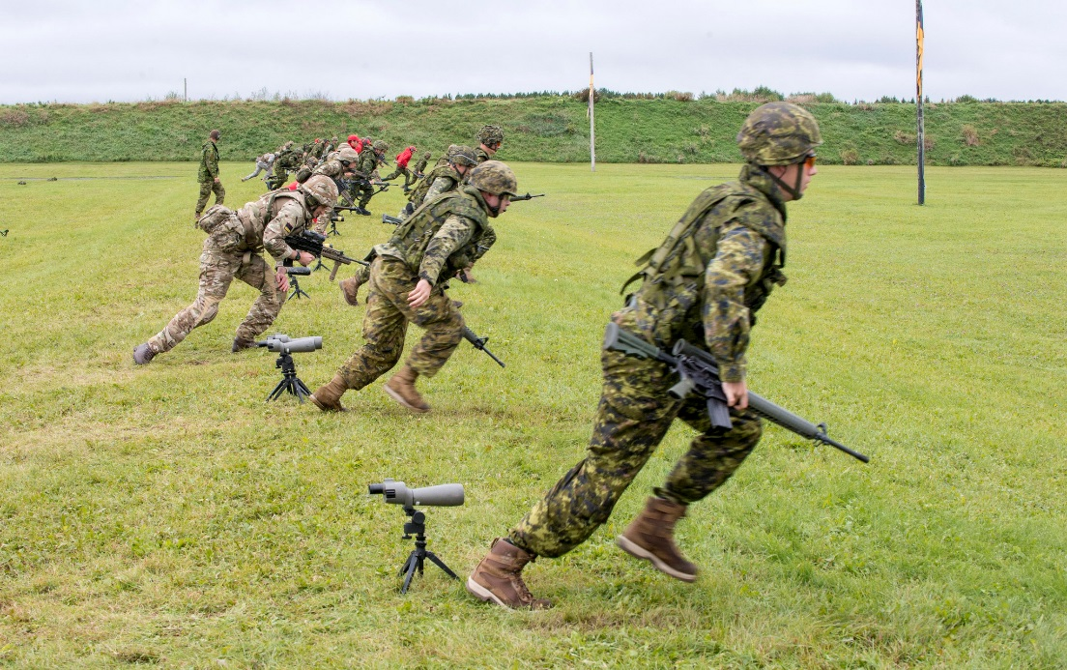
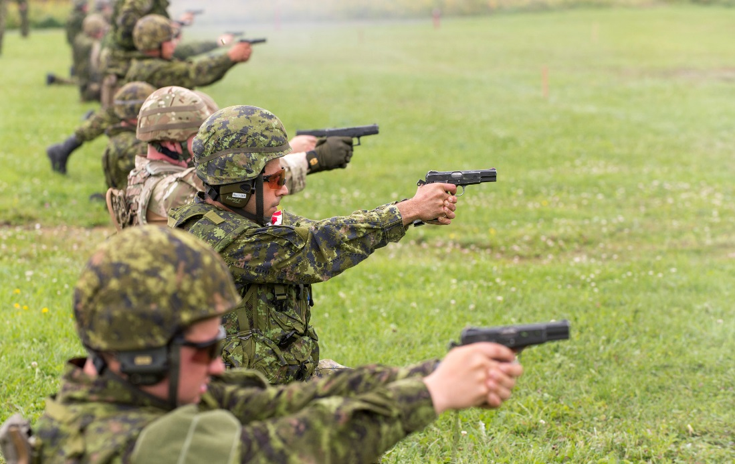
CAFSAC
What is it?
NDHQ team focuses on Rifle, Pistol, and possibly Machine Gun.
We do not compete as a team for CASAM (obstacle course, 10K run etc.), though some events may be an option for those interested.

Slide 6
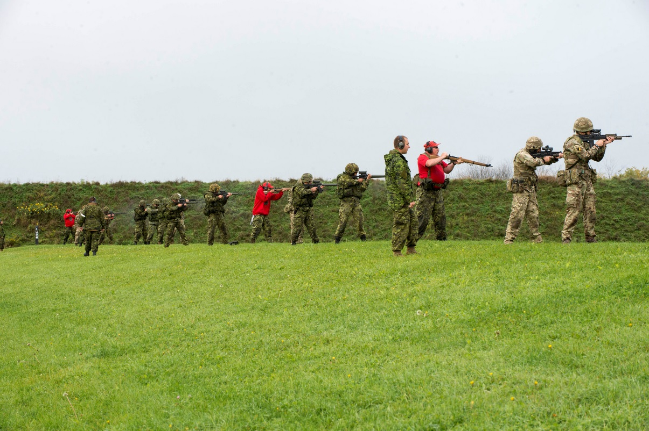
CAFSAC
What is it?
Rifle has 4 primary matches to qualify for Queens Medal match (only top 50 from Canada compete for QM)
Match 11: 200m, 100m, Deliberate prone, Rapid, Rundown – General marksmanship skills
Match 12: 100m and less, Movers, Snaps, Standing/kneeling – Target acquisition, trigger control

Slide 7

CAFSAC
What is it?
Match 13: 300m, 200m, 100m, Deliberate prone, Agony Prone, rundowns, movers, rapids – General skills, Response time/awareness
Match 14: 500m, 400m, 300m, 200m, 100m, Deliberate prone, rundowns, movers, rapids – Long distance skills (wind gauging, sight adjustment, trigger/breathing control), cardio

Slide 8
CAFSAC
What is it?
Other matches:
Night Shoot – 100m and less, NVGs with Lasers. Only a Fun shoot for us, but still possibility of medals.
Barrier Shoot – Shoot around/over walls. Fun Shoot.
Falling Plates – Rundown with 10 falling plates per team of 4. Compete against another team of 4. Fun shoot.

Slide 9
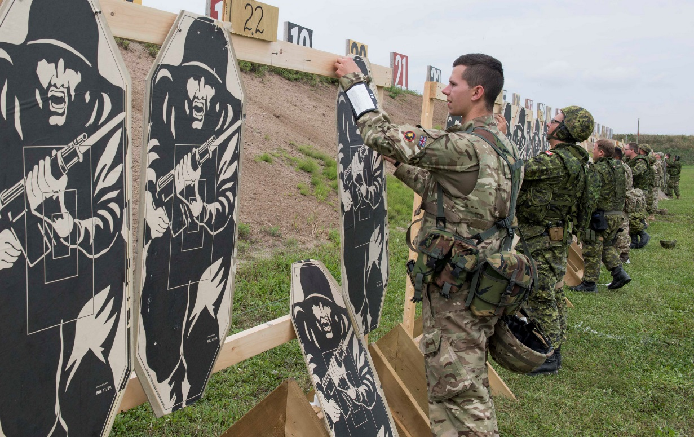

CAFSAC
What is it?
Pistol has 3 primary matches and 2 (or more) CQB matches
Match 21, 22, and 23 are matches with tight times, a variety of distances and some one handed left/right shooting. Self directed reloads will be part of the competition as well.

Slide 10
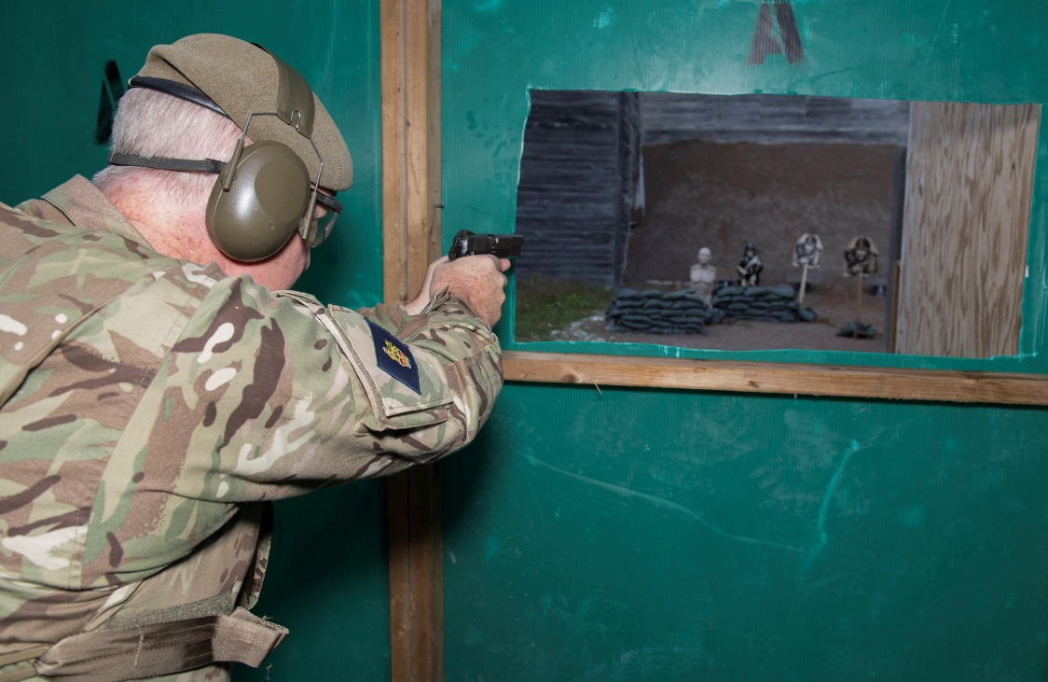
CAFSAC
What is it?
CQB matches are time based with penalties for inaccuracy, failure to reload tactically, failure to engage a target, failure to use cover, and minor safety infractions.

Slide 11
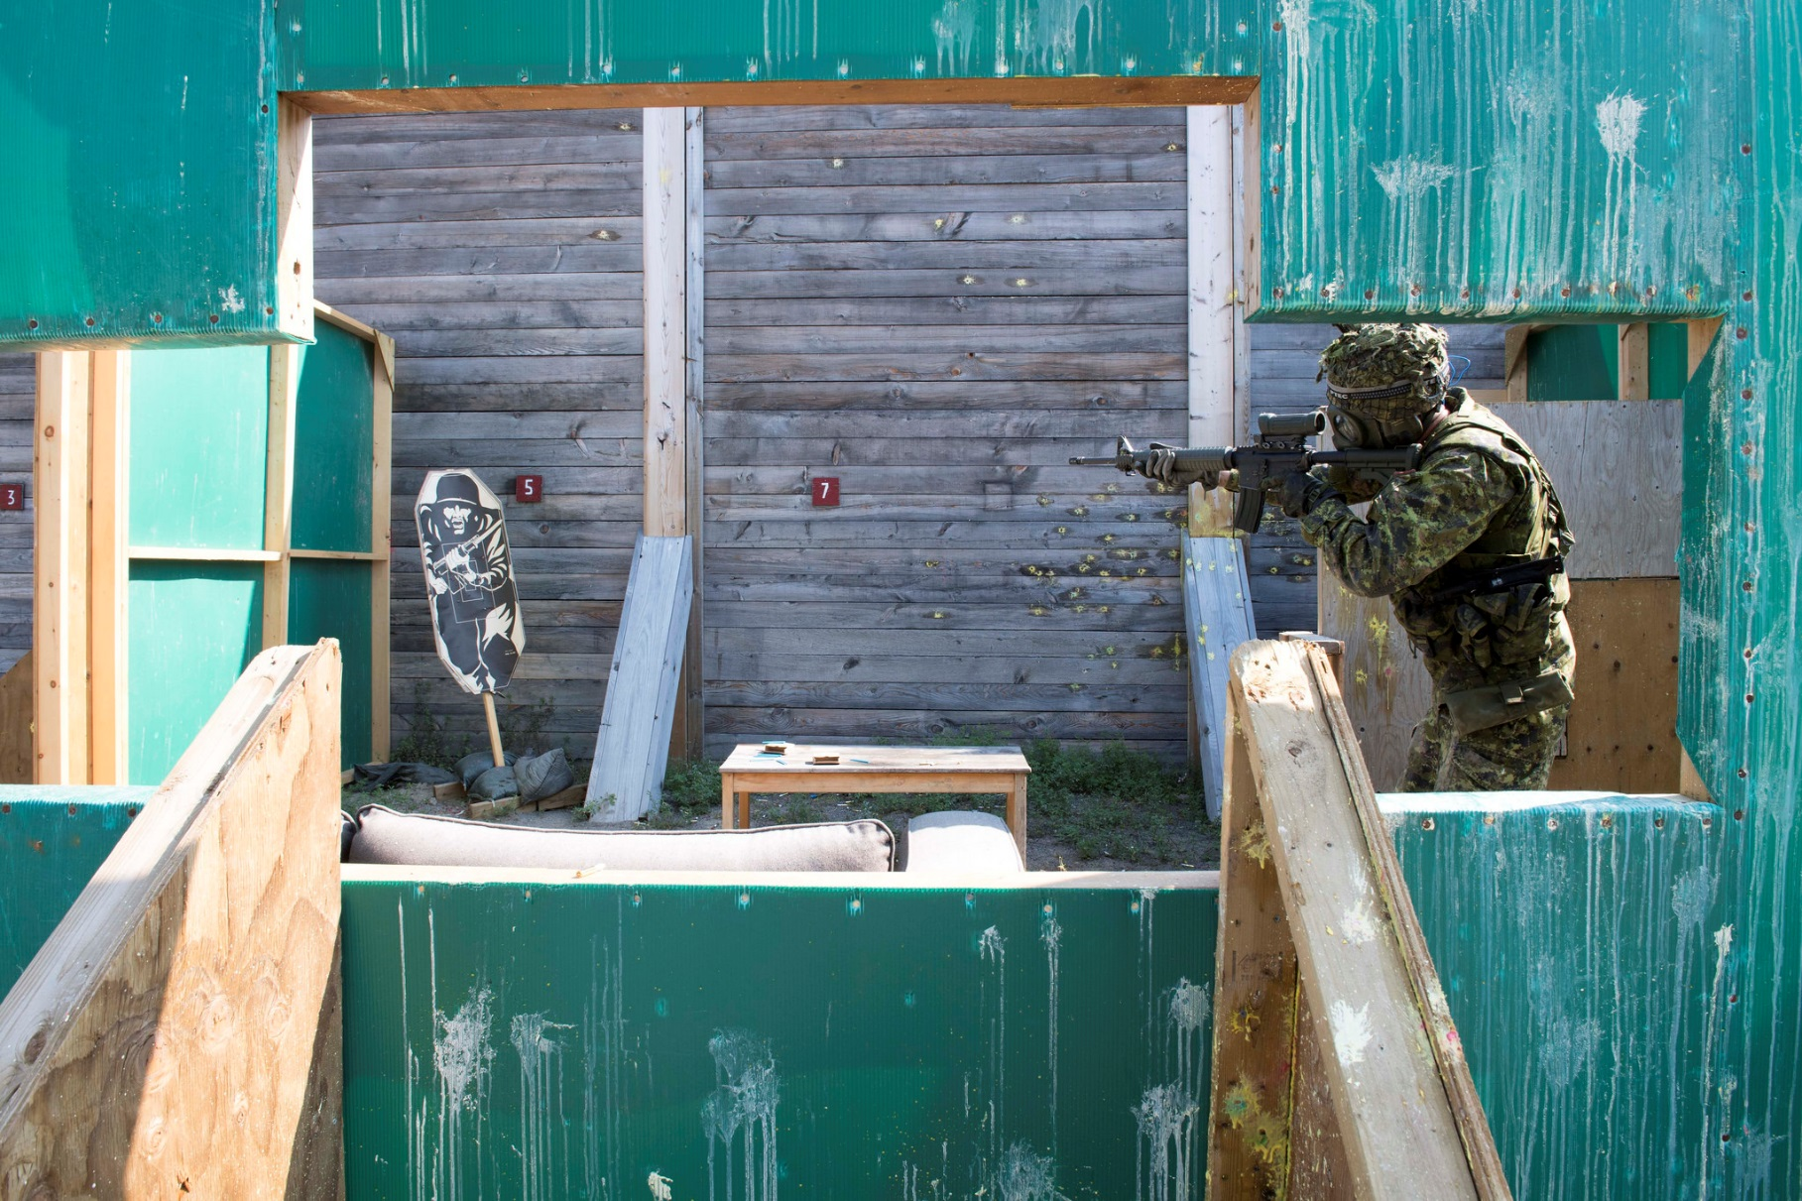
CAFSAC
What is it?
2 way range with Simunition and paintball turrets may be a CQB match.
Paintballs!!!!

Slide 12
International Competitions
The results from CAFSAC may determine which CAF members will be selected to join the CAF Combat Shooting Teams the following year in three international shooting competitions.
AFSAM (Armed Forces Skill At Arms Meeting). Held each year at the National Guard Marksmanship training center in Little Rock Arkansas. Chosen from the top combined rifle/pistol shooters.
AASAM (Australian Army Skill at Arms Meeting). Selected from top C9 team and the rest from CASAM.
Bisley, Held in the UK. CAF sends two teams one reserve, one regular force. Members are selected from matches 11-15 in service rifle.

Slide 13
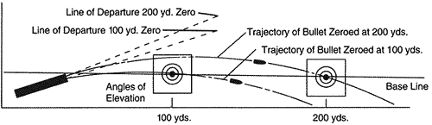
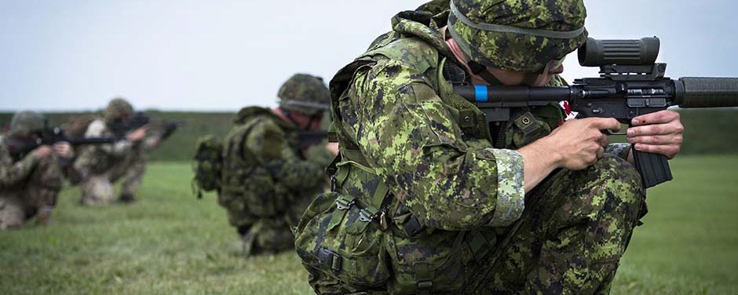
Marksmanship Principles
2 Components:
The Science
The Skill

Slide 14

Marksmanship Principles
The Skill
5 Key elements
  Breathing
  Trigger Control
  Position
  Point of Aim
  Knowledge

Slide 15
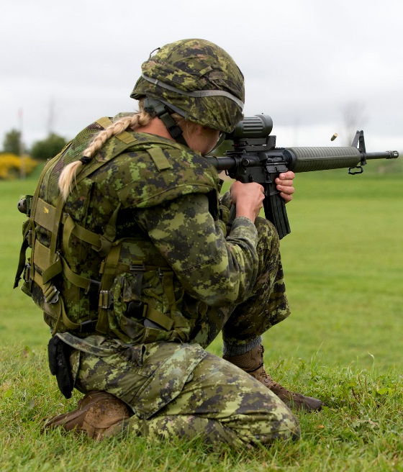
Marksmanship Principles
The Skill
Position
  Probably the second most important skill!
  A good position is necessary for Precision – Stability and relaxed body significantly reduce uncertainty.
  Requires flexibility and endurance developed over training season.

Slide 16
Marksmanship Principles
The Skill
Knowledge
  CAFSAC range instructions, words of command are minimal.
  Each competitor is obliged to know each stage of each match ahead of time.
  Only instruction: “Match X, Load, Ready. Watch and Shoot”.
  Mental Mantra prior to each stage:
    Safety, Sights, Wind, Prepare to move.

Slide 17
Marksmanship Principles
The Skill
Knowledge Cont’d
  Safety – Magazine for next stage loaded, readied, safety ON.
  Sights – Adjust elevation for next stage.
  Wind – Take the opportunity to check wind, adjust windage before next stage.
  Prepare to move – Go from a shooting stance to similar prep stance (ie from a tight kneel to high kneel) and trail arms.

Slide 18
Equipment
Team staff will provide an equipment list by email. Go to Supply soonest to pick up any items you do not have!
Confirm your Frag Vest and helmet are sized properly. The frag vest should only extend to the bottom of your belt. Longer than that and it will ride up in the kneeling position or press against your helmet in prone.
Team will issue training plates later in the season.
During competition, training plates and rank are required on frag vest. Equipment will be weighed/inspected at random to confirm.
Modification of weapons is not permitted! 2 Years ago a Reg Force Team was banned due to modified triggers.

Slide 19
Equipment
Electronic or over ear hearing protection are permitted, however at shooter’s own cost. Foamy ear-pro is provided by the team.
Always bring a notebook and pen/pencil to the range. This is to record new things you learn and to:
  note temperature and weather conditions, as well as the elevation and windage adjustments for each range/condition.
  Regular recording of sight adjustment data will assist your gauging of wind conditions and the accuracy of your adjustments.

Slide 20
What to Expect
Initial Dry Training and SAT Range Sessions
Test fit equipment. Adjust for usability.
TOETs, IAs and Stoppages.
Safety and weapon handling standards.
Movement Standards.
Practice basic firing in different positions and transitions.
Practice Breathing and trigger control.
Target acquisition and points of aim.
Tips and Tricks.

Slide 21
What to Expect
First Live Range Session
Range Setup and Equipment Sign out.
Rifle Assignment.
Sighting Rifle in at 25m and 100m.
Refine equipment fit. Adjust for usability.
Practice basic firing in different positions and transitions.
Practice Breathing and trigger control.
Target acquisition and points of aim.
Butts Operation.
Tips and Tricks.

Slide 22
What to Expect
Additional Live Range Session
Range Setup.
Walk back to each 100m up to 500m.
Advanced Techniques.
  Moving targets.
  Rapid, Deliberate.
  Agony Snaps.
  Windage.
  6 O'clock hold.
Practice Match Conditions.
Butts operations.
Tips and Tricks.

Slide 23
What to Expect
NSCC and CAFSAC
Receive and check shooter’s package.
Opening Ceremony/Photo.
Sighting and Walk back to 500m.
Review match conditions and check equipment.
Squading.
Conduct Matches.
Post matches meeting.
Protests, Interactions with staff.
Closing Ceremony.

Slide 24
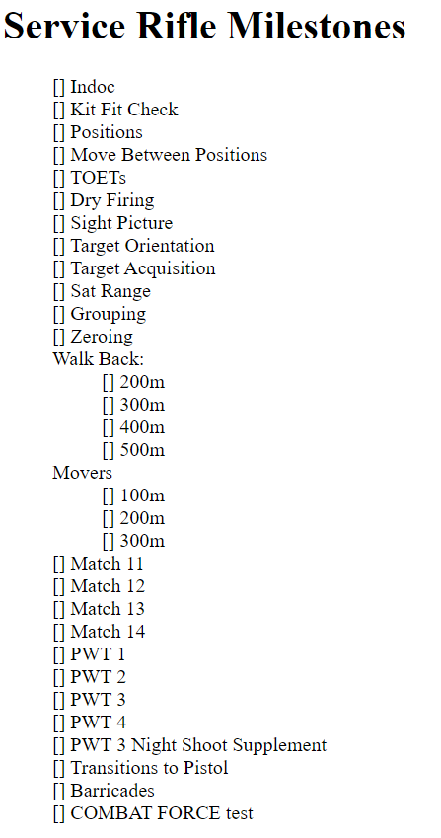
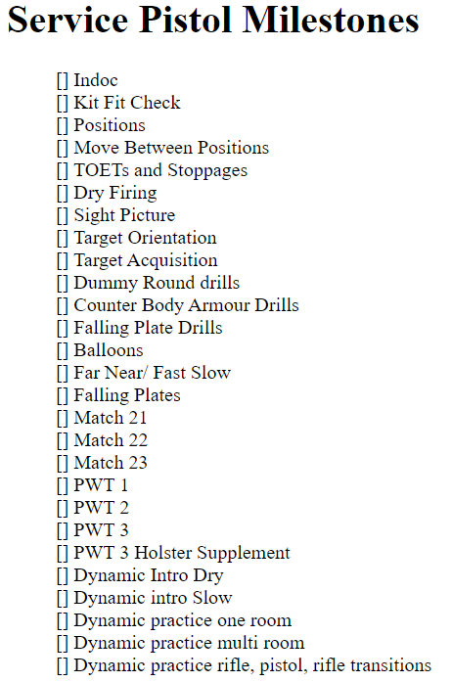
What to Expect
Personal Accomplishment Checklist

Slide 25
Senior Shooter’s Comments

Slide 26
Questions?

